Slide 1

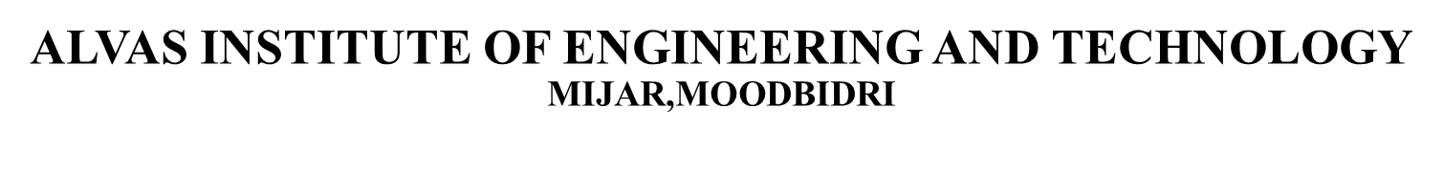

Phase 1 Report ON
LoRa and IoT based smart irrigation system
Guide:
Dr. Guruprasad B
Assistant Professor ,AIET
Presented by:
4AL19EC001 - A V VEDANTH
4AL19EC008 - ABHISHEK P
4AL19EC027 - DARSHAN S N
4AL19EC037 - JAISON V J
10/01/2023

Slide 2
CONTENT
1.Introduction
2.Problem statement
3.Objective
4.Proposed System
5.Literature Survey
6.Block diagram
7.Technical aspects
8.Project Roadmap
9.Expected output and Advantages
10. Reference
10/01/2023
LoRa and IoT based smart irrigation system

Slide 3

INTRODUCTION
Water resource one of the most important natural resource problem to be paid more attention in the world in 21st Century.
Irrigation method in traditional agriculture has low utilization of water resource with the development of IoT in this system.
In our project irrigation node sends data to cloud through LoRa gateways via wireless transmission. The system can be controlled manually and remotely by mobile applications.
LoRa and IoT based smart irrigation system

Slide 4
PROBLEM STATEMENT
Farmers used to turn ON the bore well in order to deliver the water to the agriculture field and later they need to turn OFF the motor after checking the enough availability of water in the agriculture field.
150-200 farmer dies due to snake bite and animal attack every year while they go to turn ON the motor pump during night time.
Wastage of water due to pipeline breakage and over watering.
LoRa and IoT based smart irrigation system

Slide 5
OBJECTIVE
Design system that can turn ON and turn OFF the motor after checking the enough availability of water in the agriculture field.
Design system where irrigation can be controlled from remote location where internet connection is not available(agriculture field) by using the latest technology like LoRa.
Design system which can detect the wastage of water due to pipeline breakage and over watering.
LoRa and IoT based smart irrigation system

Slide 6
PROPOSED SYSTEM
LoRa WAN
→ Communication between home and agriculture field.
→ Replace existing GSM model.
IoT(Internet of things)
→ Cloud updation.
→ App control.
→ Voice control.
LoRa
IoT
MANUAL CONTROLLING
→Manually controlling from home ,the region where the internet connection is not available.
USAGE OF SENSORS
→Pressure sensor to analyse Water pipe breakage.
→Soil moisture monitoring.
Manual
Sense
LoRa and IoT based smart irrigation system

Slide 7

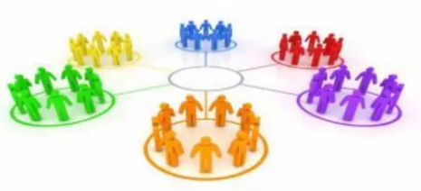

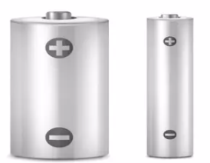
WHY LoRa ?
LONG RANGE
→ 2 - 10+ Km .
→ Indoor coverage.
→ Star topology.
MAX LIFETIME
→ Low power optimized.
→ 5-10yr lifetime.
→ Energy efficient.
MULTI USAGE
→ High capacity.
→ Multi-tenant.
→ Public network.
LOW COST
→ Minimal infrastructure.
→ Low cost end-node.
→ License-free spectrum.
LoRa and IoT based smart irrigation system

Slide 8
LITERATURE SURVEY
Daveev [1],This paper shows the useful methods that can be used in smart agriculture system with the help of LoRa technology. The sensor nodes are connected with LoRa modules in order to transfer the sensor data to the processing system, in order to upload it on cloud platform.
C. Bouras [2], Wi-Fi & LoRa as wireless technologies have been compared initially, however the end devices require high power consumption for processing and thus there is requirement of low power network technologies. Experiments carried out on real time basis indicate that LoRa could be an ideal option for building smart rescue monitoring
LoRa and IoT based smart irrigation system

Slide 9
LITERATURE SURVEY
3. C. S. Gaddam [3], This paper shows the WAN technology i.e LPWAN is popular and leading technology created for IoT networks. LPWAN is wireless based WAN technology that enables Low power consumption, long range, lower bandwidth with low bit rates.
4. A. Lavric [4], Long-range transfer of information is enabled by LoRa modules, with a low transfer rate. Considering the requirements this paper presents the evaluation of the LoRa technology in the field of IoT and Architecture requirements of LoRa WAN communication protocol have been discussed along with the evaluation of LoRa modulation performance.
LoRa and IoT based smart irrigation system

Slide 10
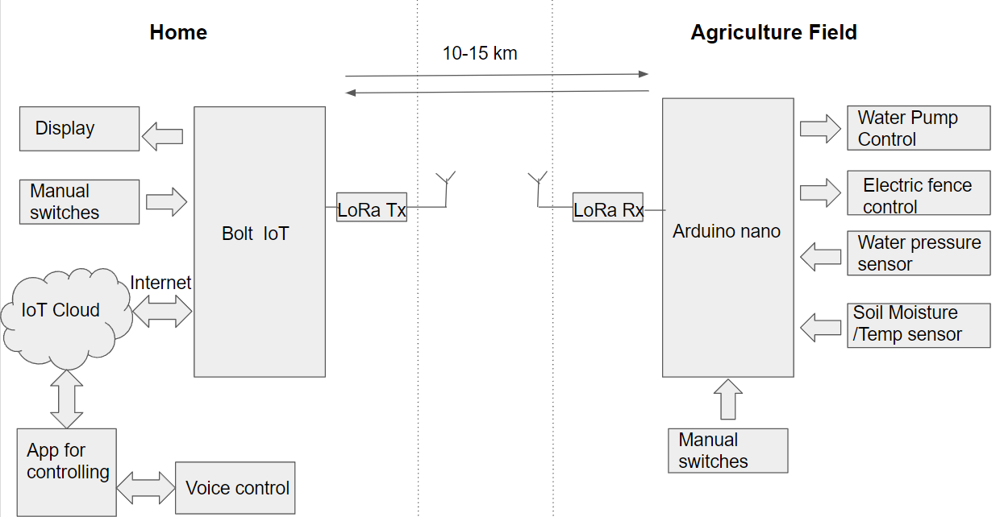
BLOCK DIAGRAM
LoRa and IoT based smart irrigation system

Slide 11
TECHNICAL ASPECTS
LoRa (Long Range) technology
Sensors
Central controller
Valves and pumps
Power source
LoRa and IoT based smart irrigation system
Notes:
LoRa (Long Range) technology: LoRa is a low-power, long-range wireless communication technology that can be used to transmit data over long distances with low power consumption.
Sensors: A LoRa-based smart irrigation system will typically use a variety of sensors to gather data about soil moisture levels, temperature, and other factors that can affect the irrigation process. T
Central controller: The central controller is the brain of the smart irrigation system. It receives data from the sensors and uses this information to determine when and how much to water the plants. The controller may also be connected to a user interface, such as a smartphone app, that allows the user to view and control the irrigation process.
Valves and pumps: In a smart irrigation system, the central controller will typically be connected to valves and pumps that control the flow of water to the plants. These valves and pumps may be controlled via LoRa, or they may be connected directly to the controller.
Power source: This could be a battery, a solar panel, or a connection to the electrical grid.

Slide 12
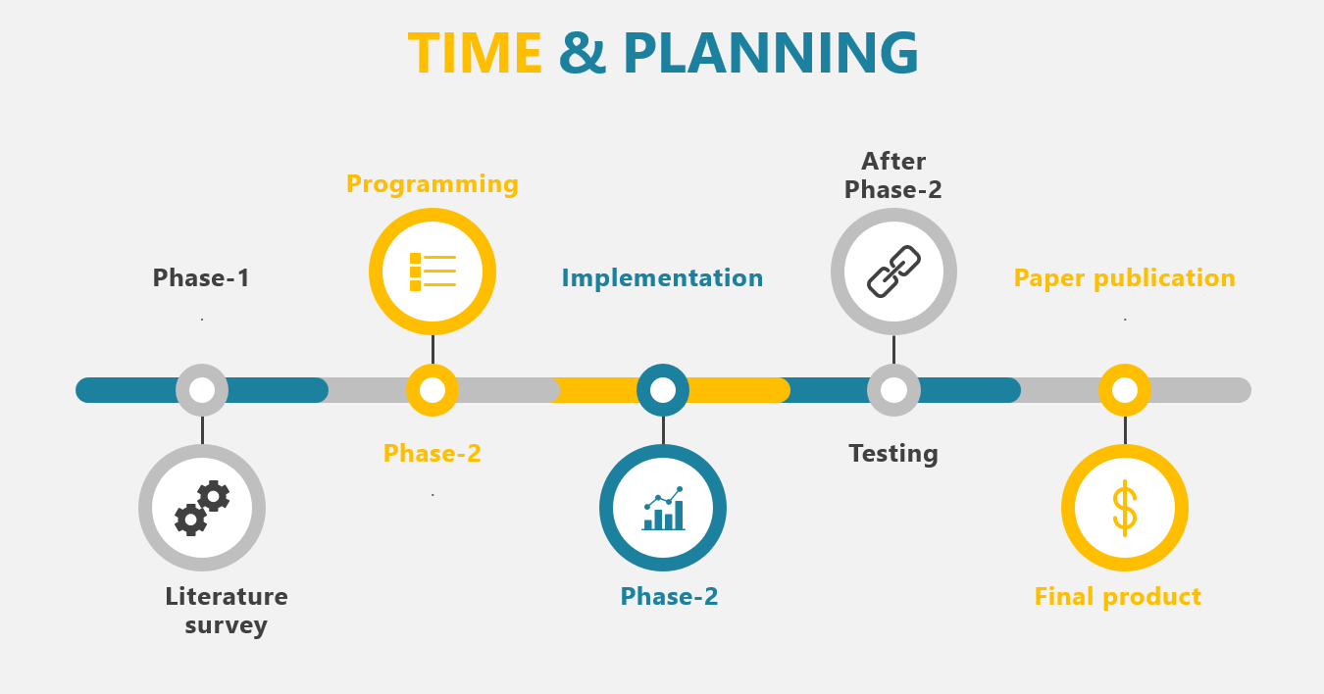
LoRa and IoT based smart irrigation system

Slide 13
EXPECTED OUTPUT
Increased efficiency: A smart irrigation system can help to reduce water usage by only watering plants when they need it, rather than on a fixed schedule. This can help to conserve water and reduce water bills.
Increased crop yield: By ensuring that plants receive the right amount of water at the right time, a smart irrigation system can help to optimize crop growth and increase crop yield.
Reduced labour costs: An automated irrigation system can reduce the amount of labour needed to manage irrigation, saving time and money.
LoRa and IoT based smart irrigation system

Slide 14
EXPECTED OUTPUT (CONTND…)
Improved plant health: By providing plants with the right amount of water at the right time, a smart irrigation system can help to improve plant health and reduce the risk of drought-related plant stress.
Improved monitoring and control: A LoRa and IoT based smart irrigation system allows farmers to monitor and control the irrigation process remotely using a smartphone app or other user interface. This can provide greater flexibility and convenience compared to traditional irrigation methods.
LoRa and IoT based smart irrigation system

Slide 15
ADVANTAGES
1.Can resist Minimizing current consumption.
2.High reliability.
3.Maximum range of 10 km.
4.Allow small farms to have affordable precision irrigation (low cost).
5.Provides of solution for scarcity of water.
6.Helps to get good yield for farmers.
LoRa and IoT based smart irrigation system

Slide 16
REFERENCES
Daveev, K. Mitreski, S. Trajkovic, V. Nikolovski and N. Koteli, “IoT agriculture system based on LoRa WAN," 2018 14th IEEE International Workshop on Factory Communication Systems (WFCS), Imperia, 2018.
C. Bouras, A. Gkamas, V. Kokkinos and N. Papachristos, "Using LoRa Technology for IoT Monitoring Systems," 2019 10th International Conference on Networks of the Future (NoF), Rome, Italy, 2019.
C. S. Gaddam and M K. Rai, "A Comparative Study on Various LPWAN and Cellular Communication Technologies for IoT Based Smart Applications," 2018 International Conference on Emerging Trends and Innovations In Engineering And Technological Research (ICETIETR), Ernakulam, 2018,
A. Lavric and V Popa, "Internet of Things and LoRa™ Low-Power Wide-Area Networks: A survey," 2017 International Symposium on Signals, Circuits and Systems (ISSCS), Iasi, 2017
LoRa and IoT based smart irrigation system

Slide 17
THANK YOU
LoRa and IoT based smart irrigation system

